Slide 1
CAPTCHA CRACKER
Project By:-
Priyanshu Parikh
Parth Kumar Rawal
Dhaval B. Patel
Supervised By:-
Prof. Vishal Barot

Slide 2
INDEX
Introduction
Types of CAPTCHAs
Preliminary Work Summary
Our Approach
Neural Networks
Experiments
Results
Conclusion

Slide 3
Intoduction
We are trying to decode CAPTCHAs using machine learning and deep learning.
CAPTCHA: Completely Automated Public Turing test to tell Computers and Humans Apart.
Helps to distinguish between humans and computers.
First mentioned in a paper by Moni Naor [1] in 1996.

Slide 4
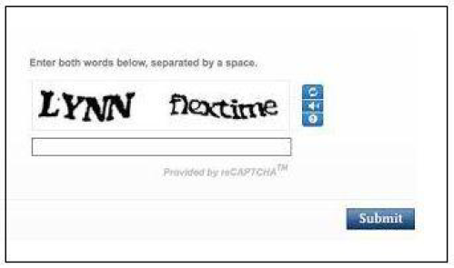
Characteristics of a CAPTCHA:
• Easy for a human to decode
• Difficult for a Computer to recognize.

Slide 5
Why Decode CAPTCHAs??
AI Problem
Security Breach
CAPTCHAs are critical for security on internet, if they are no more secure, our system won’t be secure and we would have to think of alternatives.

Slide 6
Types of CAPTCHAs
1. Standard Image Based CAPTCHA
2. Math Solution CAPTCHA
3. Picture Identification CAPTCHA
4. Ad-injected CAPTCHA
5. 3D CAPTCHA
6. jQuery sliderbar CAPTCHA
7. Drag and Drop CAPTCHA
8. Game CAPTCHA
9. reCAPTCHA

Slide 7
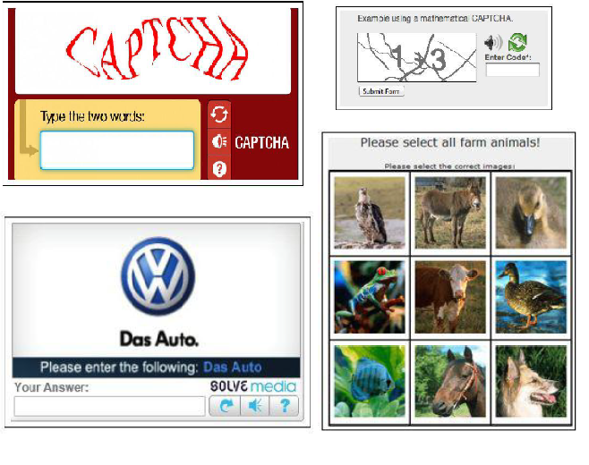
Types of CAPTCHAs:

Slide 8
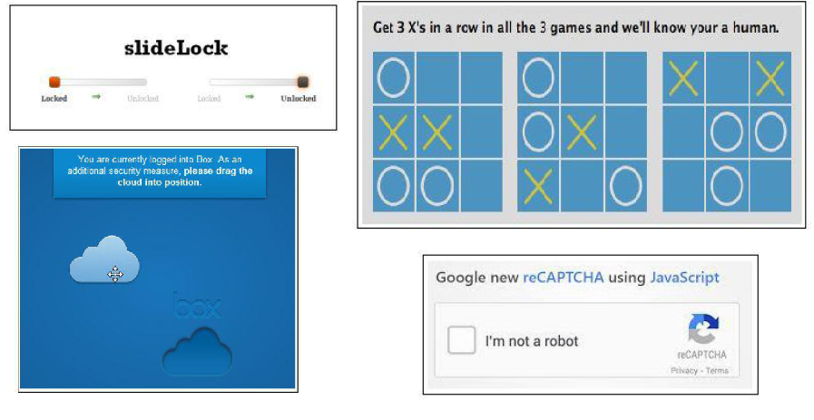

Slide 9
Preliminary Work Summary
Breaking CAPTCHAs is not a new concept.
Mori and Malik [2] have broken EZ-Gimpy (92% success) and Gimpy (33% success) CAPTCHAs with sophisticated object recognition algorithms.
People [3] also have used the following approach for CAPTCHA recognition:
○ Preprocessing.
○ Segmentation.
○ Training the model for individual character recognition.
○ Generating sequence with highest probability

Slide 10
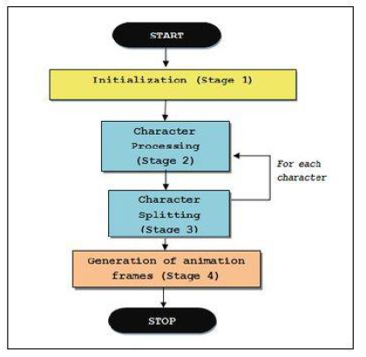
FLOW CHART

Slide 11
Our Approach
Yann Le Cun used neural networks for handwritten digits
recognition in 1990[6].
Google has published a paper[4] in which they used
convolutional neural networks to detect home addresses
from street view home plate images.
One more paper from Google[5] in which they used
recurrent neural network to generate caption for an image.
We will try combining these ideas !

Slide 12
Our Approach
End to End model. Systems with multiple modules following conventional approach tend to behave poorly, because each module is optimized independently and the errors between modules compound. We learned an end to end model that predicts directly from pixels.
Convolutional neural network for Image features and,
Recurrent neural networks for generating output sequence.
K-Nearest Neighbours

Slide 13
Tools and Technology
Python 3
Pytesseract library
OpenCV
Keras
Tensorlflow
Optical Character Recognition(OCR)

Slide 14
Algorithms
Single Character Recognition
  1. Using Pytesseract
  2. k-means Clustering
  3. Support Vector machine (SVM)
  4. Convolutional Neural Network(CNN)
Multi CAPTCHA Recognition
  1. Moving Window Algorithm
  2. Multi CNN Algorithm

Slide 15
Brief History of Neural Network
Started way back in 1940’s.
Became unpopular in 1960’s
Regained popularity in 1980’s
Recently have become one of the hottest areas in the field of machine learning.
Applications involve face recognition used by Facebook,
Image captioning used by Google etc

Slide 16
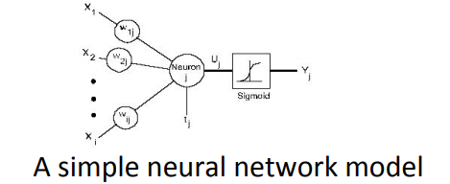
What are Neural Networks
Inspired from human brain
Many input units and one output unit.
The inputs are scaled with weights on which an activation function is applied to get the output.

Slide 17
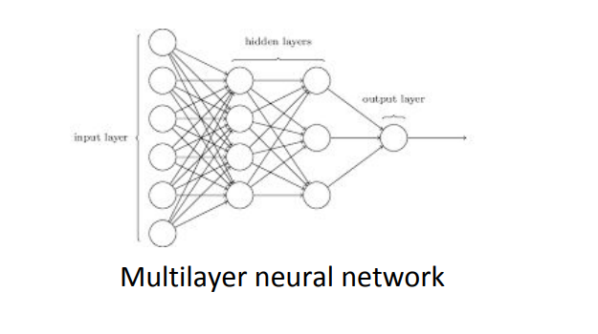

Slide 18
Training Neural Networks
Backpropagation algorithm.
The problem is set up as minimization of a loss (objective) function.
Weights are adjusted using gradients and learning rate.
Gradients are computed using simple derivative chain rule.

Slide 19
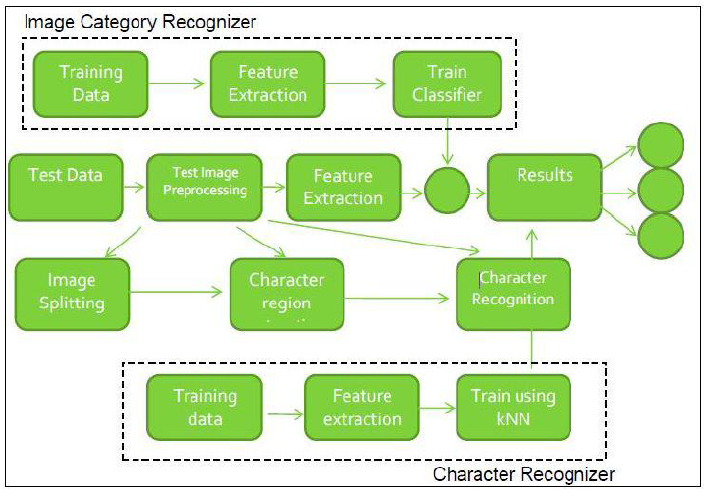
K-Nearest Neighbours

Slide 20

When do we use KNN algorithm?
KNN can be used for both classification and regression predictive problems. However, it is more widely used in classification problems in the industry. To evaluate any technique we generally look at 3 important aspects:
1. Ease to interpret output
2. Calculation time
3. Predictive Power
KNN algorithm fairs across all parameters of considerations. It is commonly used for its easy of interpretation and low calculation time.

Slide 21
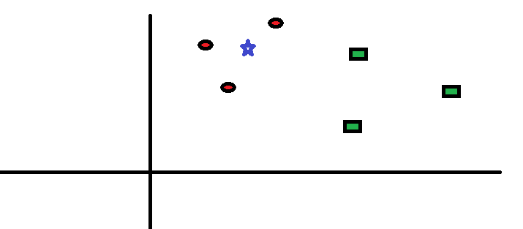
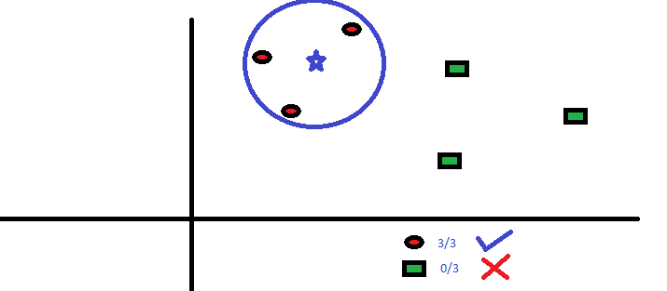
How does the KNN algorithm work?

Slide 22
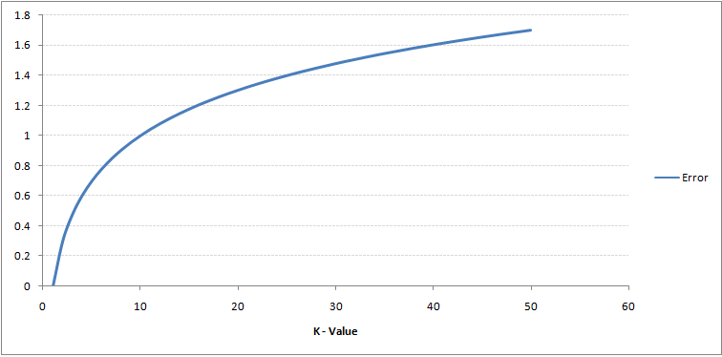
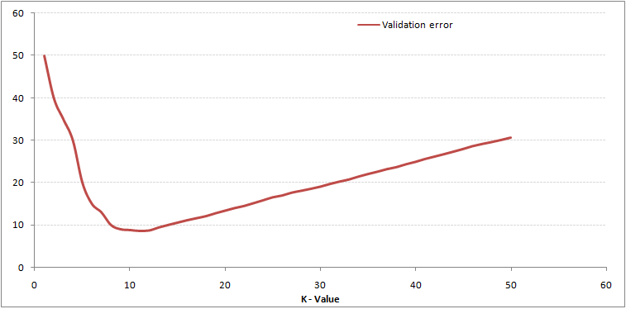
How do we choose the factor K?

Slide 23
Convolutional Neural Network
Convolutional Neural Networks are a special kind of multi-layer neural networks.
In 1995, Yann LeCun Et al. introduced the concept of convolutional neural networks [7].
Convolutional Neural Networks are designed to recognize visual patterns directly from pixel images with no preprocessing.

Slide 24
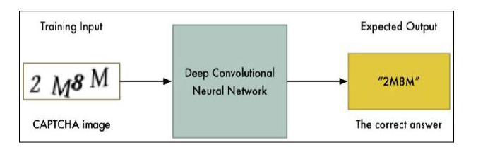
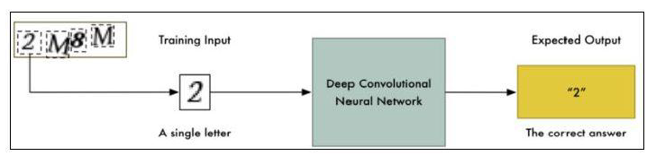
CNN

Slide 25
Feature Extraction
Shared weights: The same filter weights are applied to all the pixels.
It helps in detecting same feature at different locations of an image.
This reduces the number of paramters to be learned.
For Instance, if image size is 200*50, filter size is 5*5 and if there are 32 filters, we have only 32*(5*5 +1) (1 for bias) = 832 weights to learn.
Otherwise it would have been number_of_pixels*number_of_pixels*filters, which would be 200*50*200*50*32 = 3.2 million.
This is several orders of magnitude larger than what we have in CNNs.

Slide 26
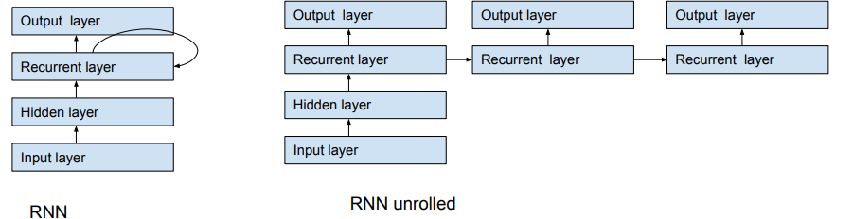
Recurrent Neural Networks
Feedforward networks accept only fixed sized input and give output of fixed length, whereas RNNs can work with variable length inputs and outputs.
In RNNs, connections between units have a directed cycle.
Various applications of RNNs include handwriting recognition and speech recognition.

Slide 27
DATASET
We will use PyCaptcha, a python package for CAPTCHA generation, to make custom CAPTCHA image dataset.
This package offers several degrees of freedom such as font style, distortion and noise, which we can exploit to increase the diversity of our data and the difficulty of the recognition task.

Slide 28
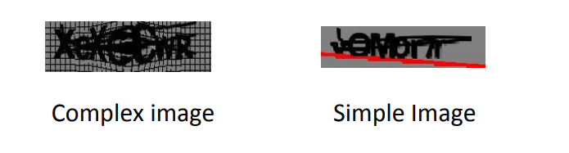
DATASET
An image contains 4-7 characters, if it is variable length dataset or 5 characters if it is a fixed length captcha.
A character could be A-Z, a-z or 0-9.
All the images generated are of same size i.e. (200*50).

Slide 29
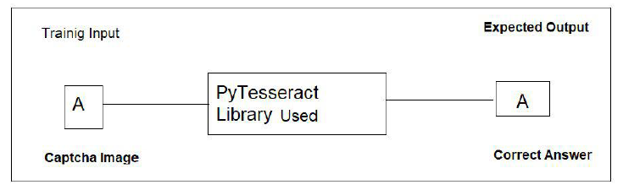
Experiments
Single Character Recognition

Slide 30
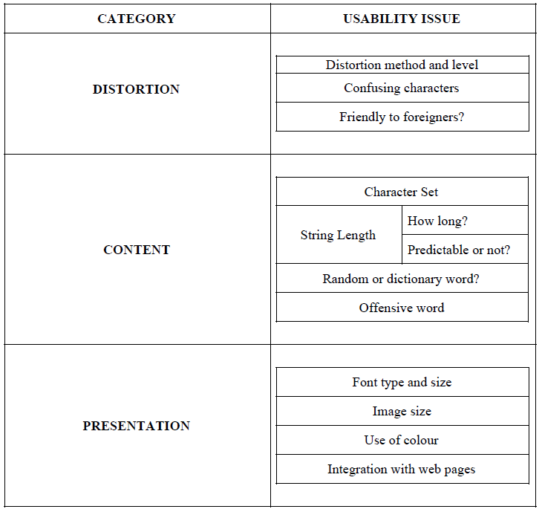
ISSUES AND LIMITATION

Slide 31
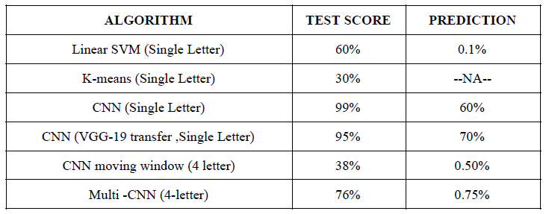
Results

Slide 32
CONCLUSION
Deep neural networks showed a really good performance in decoding CAPTCHAs with 80% and 99.8% accuracy for variable and fixed length CAPTCHAs respectively.
CAPTCHAs are not more secure as computers can do better than humans.

Slide 33
Future Work
Will try to work on accuracy using convolutional layers.
Will make the system robust by increasing the variety in training data.
For math solution CAPTCHAs we will implement Natural Language Processing Algorithms to our project and try to break that kind of CAPTCHAs.
For identifying the Picture Based CAPTCHAs we will try for Google Reverse Image System that will identify similar kind of images that is given in the CAPTCHAs image and we will try to implement that algorithm to our project.

Slide 34
References
[1] Moni Naor. Verification of a human in the loop or Identification via the Turing Test. Unpublished Manuscript, 1997.
[2] Greg Mori and Jitendra Malik. Recognising Objects in Adversarial Clutter: Breaking a Visual CAPTCHA, IEEE Conference on Computer Vision and Pattern Recognition (CVPR'03), Vol 1, June 2003, pp.134-141.
[3] Kumar Chellapilla, Patrice Y. Simard Using Machine Learning to Break VisualHuman Interaction Proofs (HIPs) Microsoft Research, one microsoft way, WA 98052 -2005
[4] Ian J. Goodfellow, Yaroslav Bulatov, Julian Ibarz, Sacha Arnoud, Vinay Shet. Multi-digit Number Recognition from Street View Imagery using Deep Convolutional Neural Networks,14 Apr 2014.
[5] Oriol Vinyals, Alexander Toshev, Samy Bengio, Dumitru Erhan, Show and Tell: A Neural Image Caption Generator, 20 Apr 2015
[6] Y.Le Cun Et. al. Handwriting Character Recognition using Neural Network Architecture.1990
[7] Y. LeCun and Y. Bengio. Convolutional networks for images, speech, and time-series. In M. A. Arbib, editor, The Handbook of Brain Theory and Neural Networks. MIT Press, 1995.

Slide 35

THANK YOU!!

